Slide 1
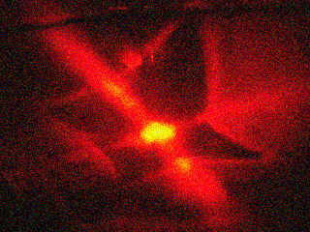
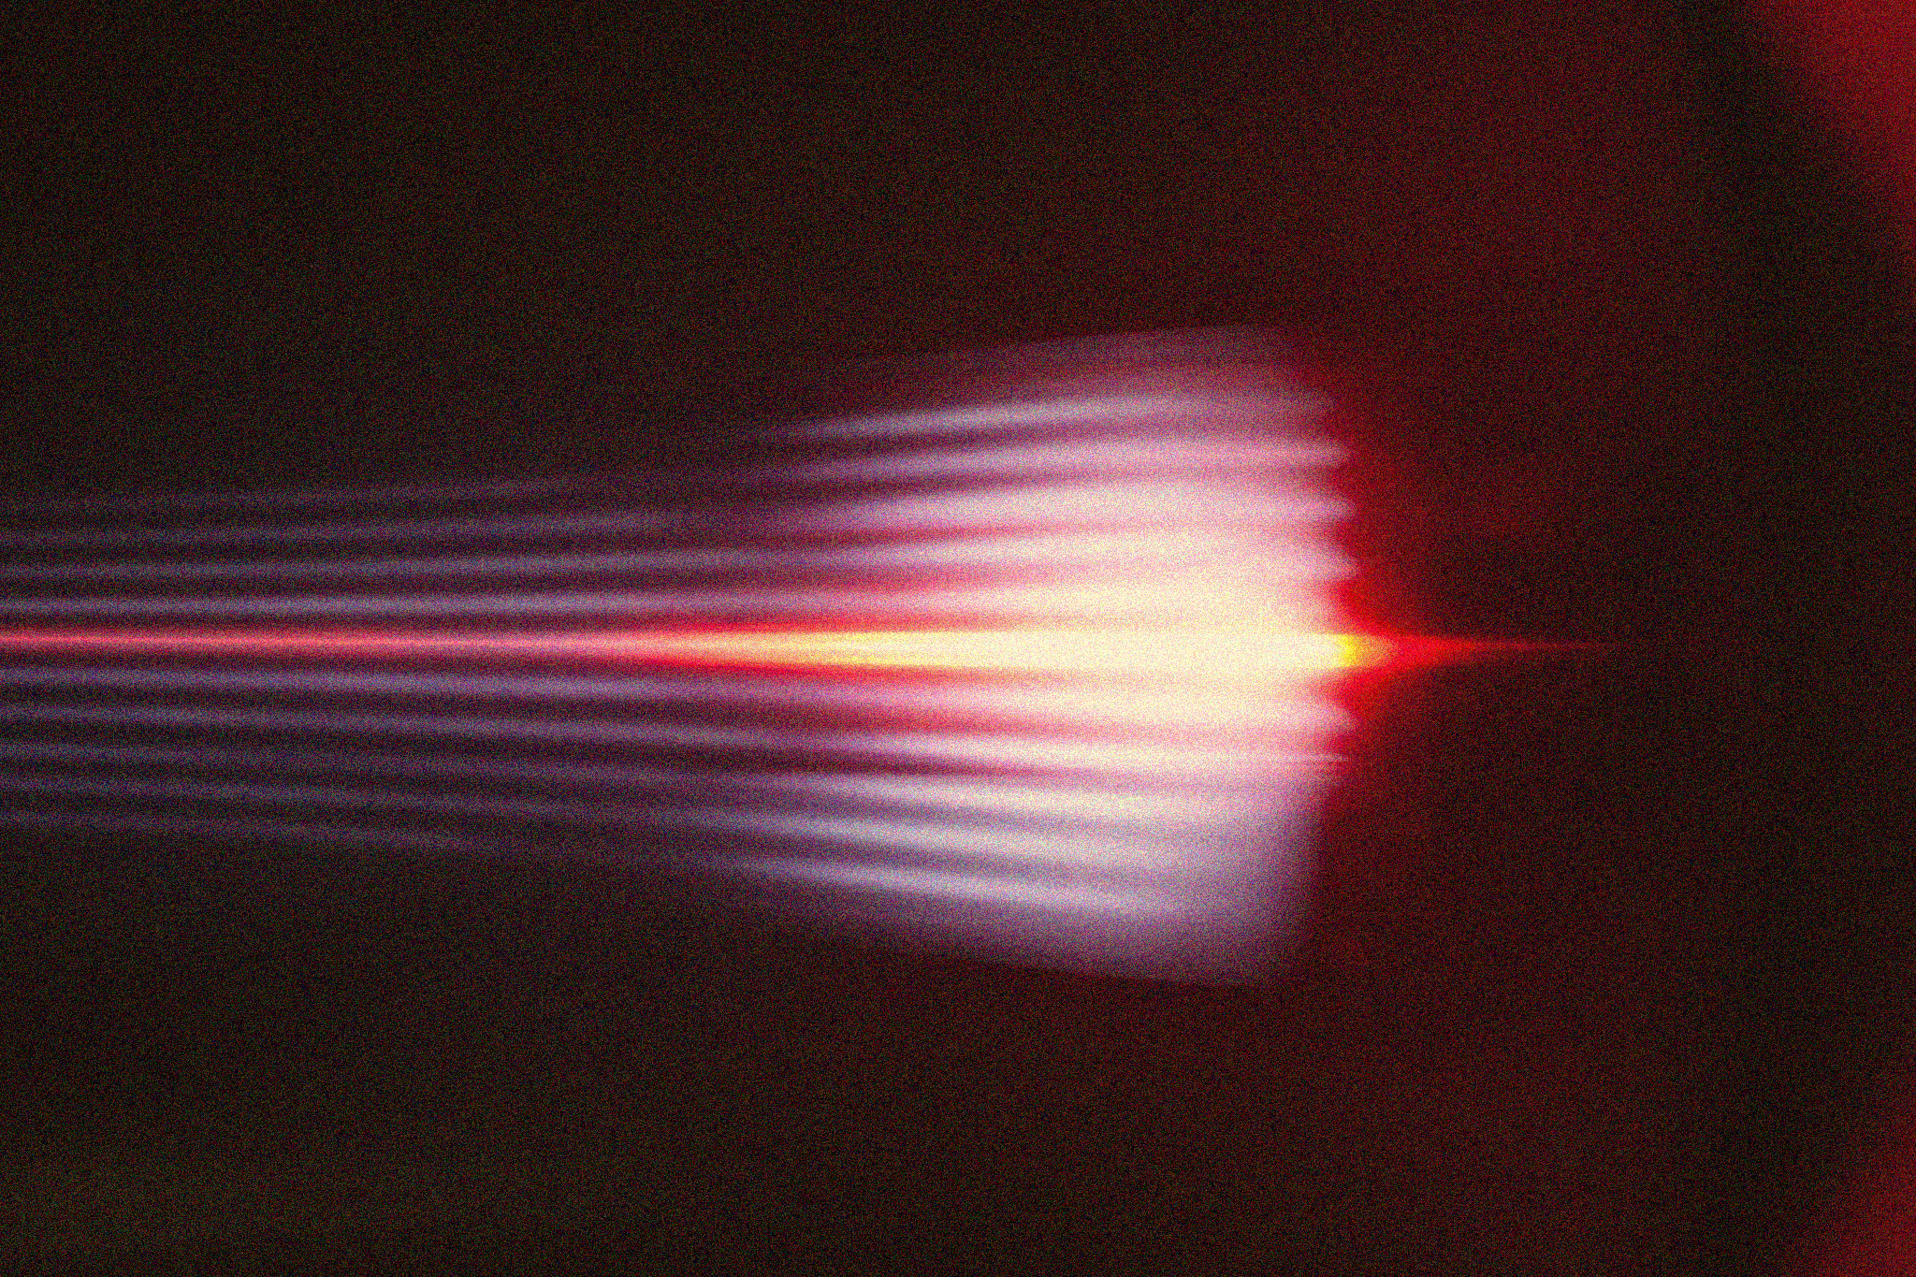
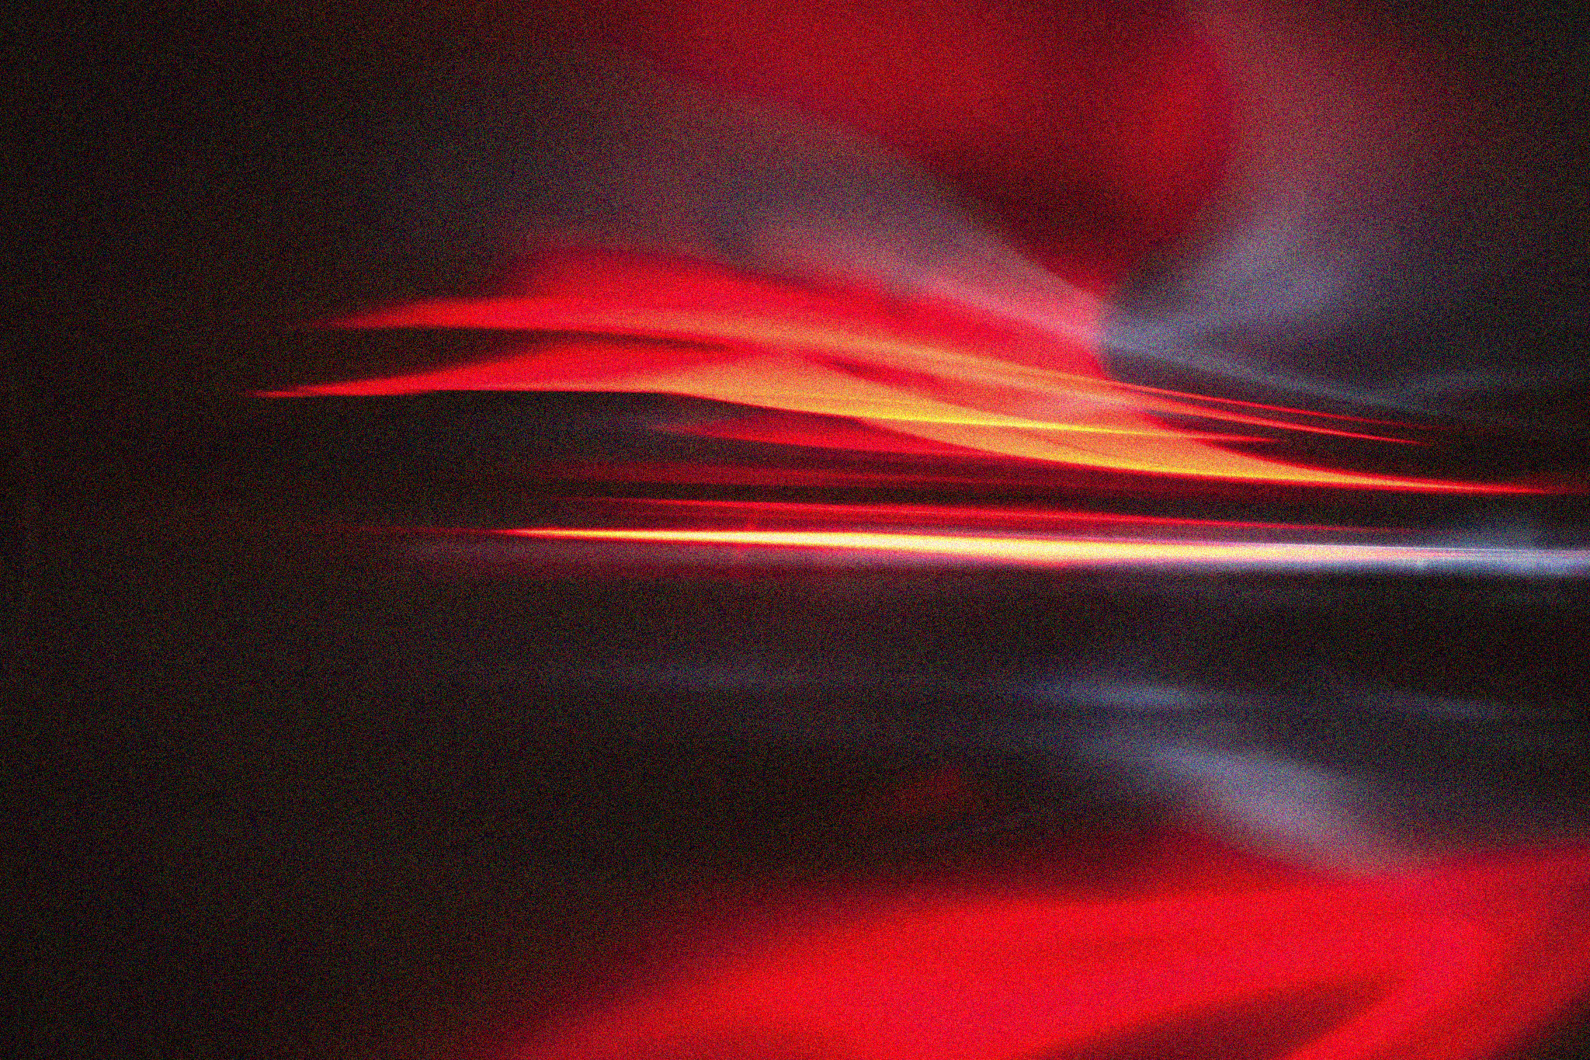
APP PHYSICS 157
COMPUTATIONAL ANALYSIS AND MODELLING
FOURIER TRANSFORM MODEL OF
IMAGE FORMATION
IMAGE AND VIDEO PROCESSING – MODULE 1
NINO PHILIP RAMONES | GITHUB
2020 – 05616
MARCH 24, 2023
This Photo by Unknown Author is licensed under CC BY-NC-ND

Slide 2
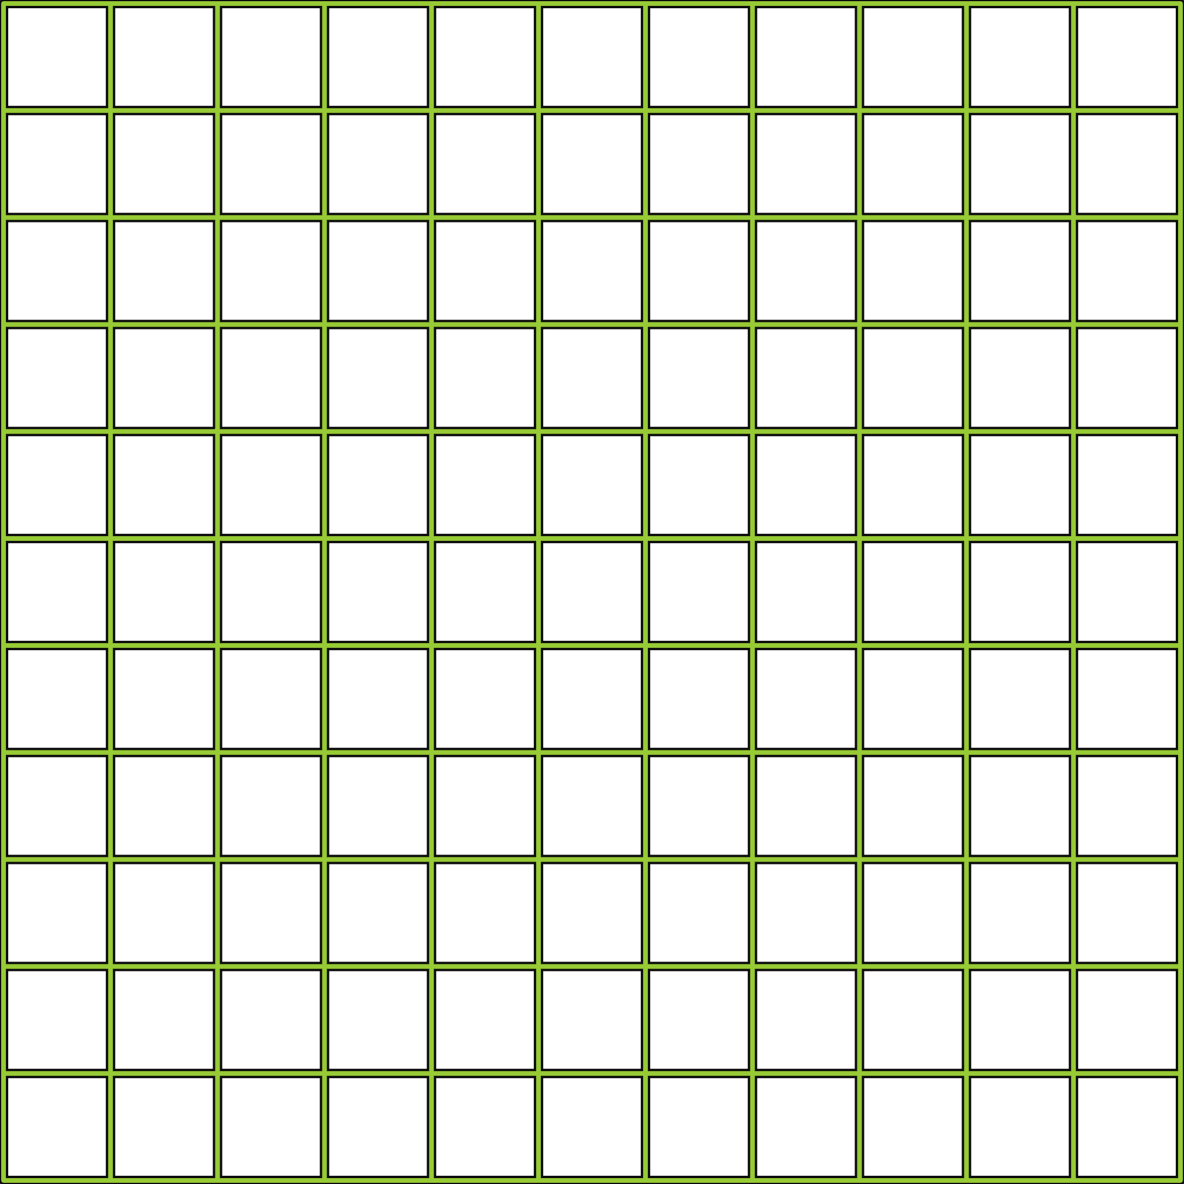
APP PHYSICS 157
FOURIER TRANSFORM MODEL OF IMAGE FORMATION
OBJECTIVES
Familiarize with the rudiments of Fourier transform and its various applications in simulating diffraction patterns and various imaging systems
Observe how Fourier transform comes into play in image convolution and correlation and how it applies to real world scenarios
KEY TAKEAWAYS
Lagay ka here
SOME PITFALLS
Lagay ka here

Slide 3
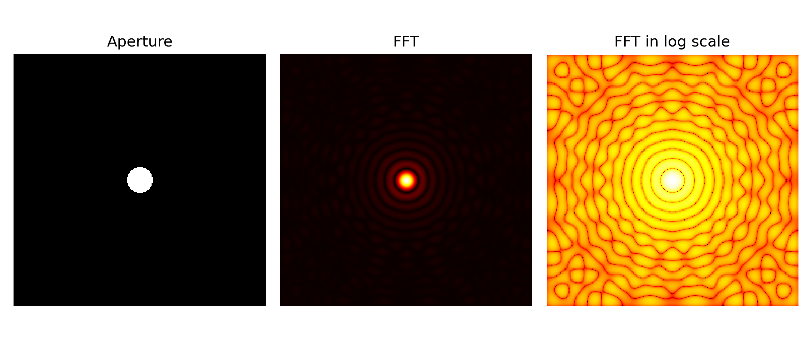
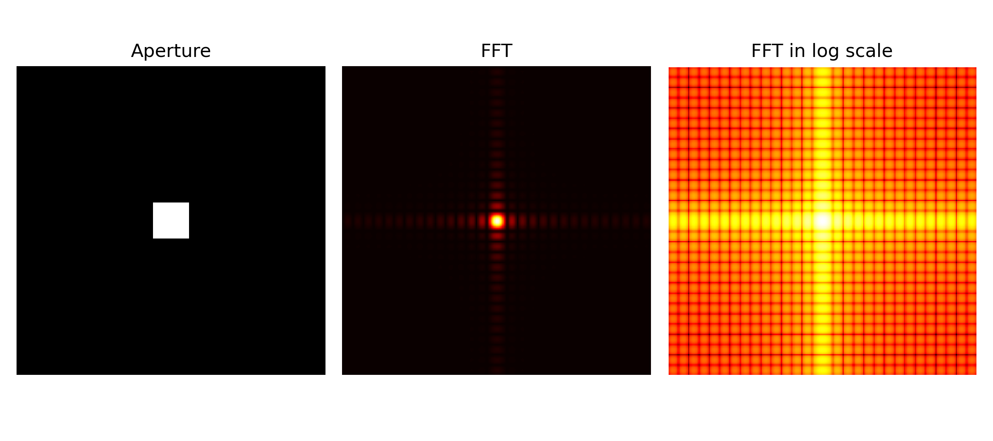
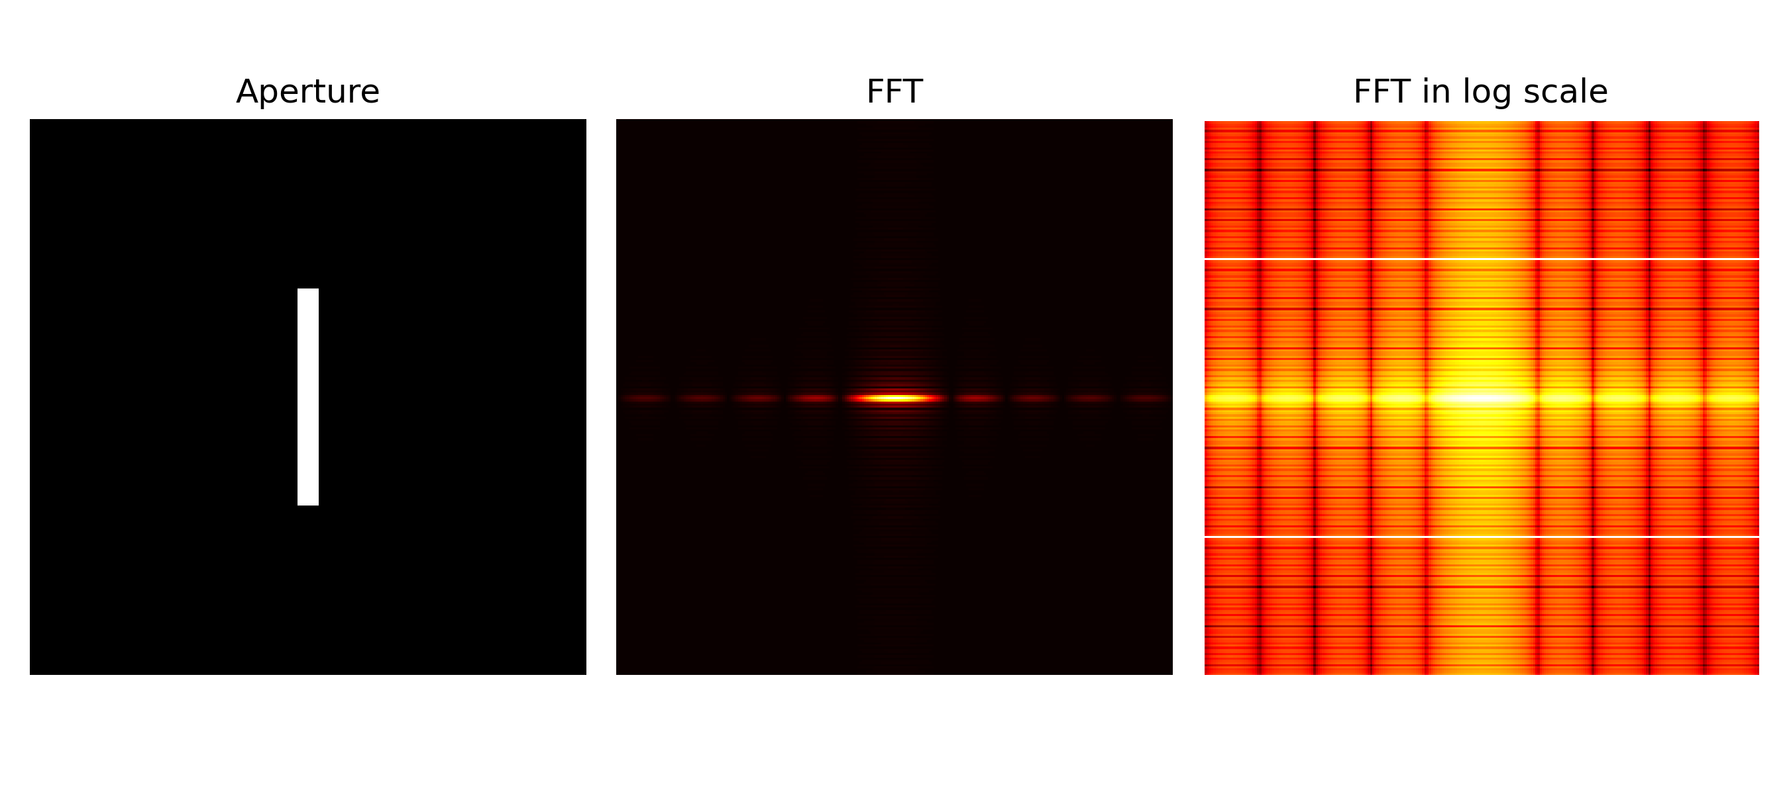
APP PHYSICS 157
FOURIER TRANSFORM MODEL OF IMAGE FORMATION
FAR FIELD DIFFRACTION PATTERNS
As described and modelled by Fraunhoffer diffraction.
The first part of the activity involves the creation of synthetic images of apertures of varying shapes and sizes and taking its corresponding Fourier transform. We observe interesting diffraction patterns of a light beam, or monochromatic plane wave in general, as it strikes a given aperture, set in a 256 by 256 image resolution.
For brevity, it was considered to project the FFT of the aperture in the logscale to see the patterns explicitly. Some of the key results were shown on the right and on the next slides!

Slide 4
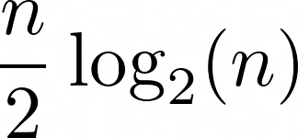
APP PHYSICS 157
FOURIER TRANSFORM MODEL OF IMAGE FORMATION
WHY DO WE USE 256 OR ANY 2^{N}?
The Fast Fourier Transform (FFT) is said to be the faster implementation of the Discrete Fourier Transform (DFT), for which the activity intends to simulate. In general, FFT algorithm reduces an n-point FT to about
complex multiplications. Since 256 data points were set for the images in this activity, the DFT calculation would simply go through the resolution by 256 times 256 or around 2¹⁶ multiplications. Comparatively, the FFT algorithm would only take, using the equation above, 1024 calculations only, which is faster by a factor of 64 times! These makes computations much faster for 2^{N} discrete points as it all boils down to the computer doing all the mathematical rigors with ease.

Slide 5
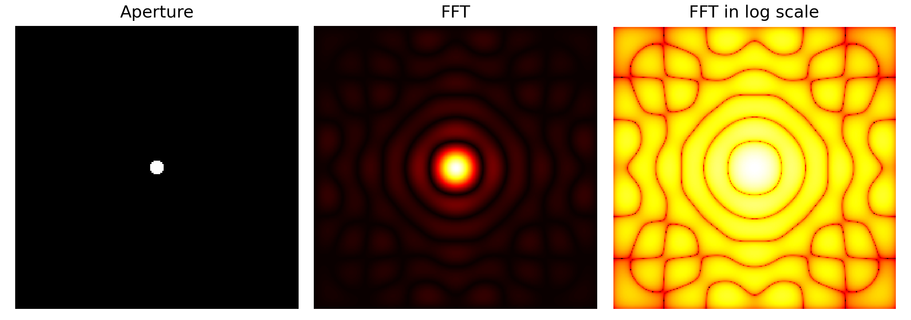
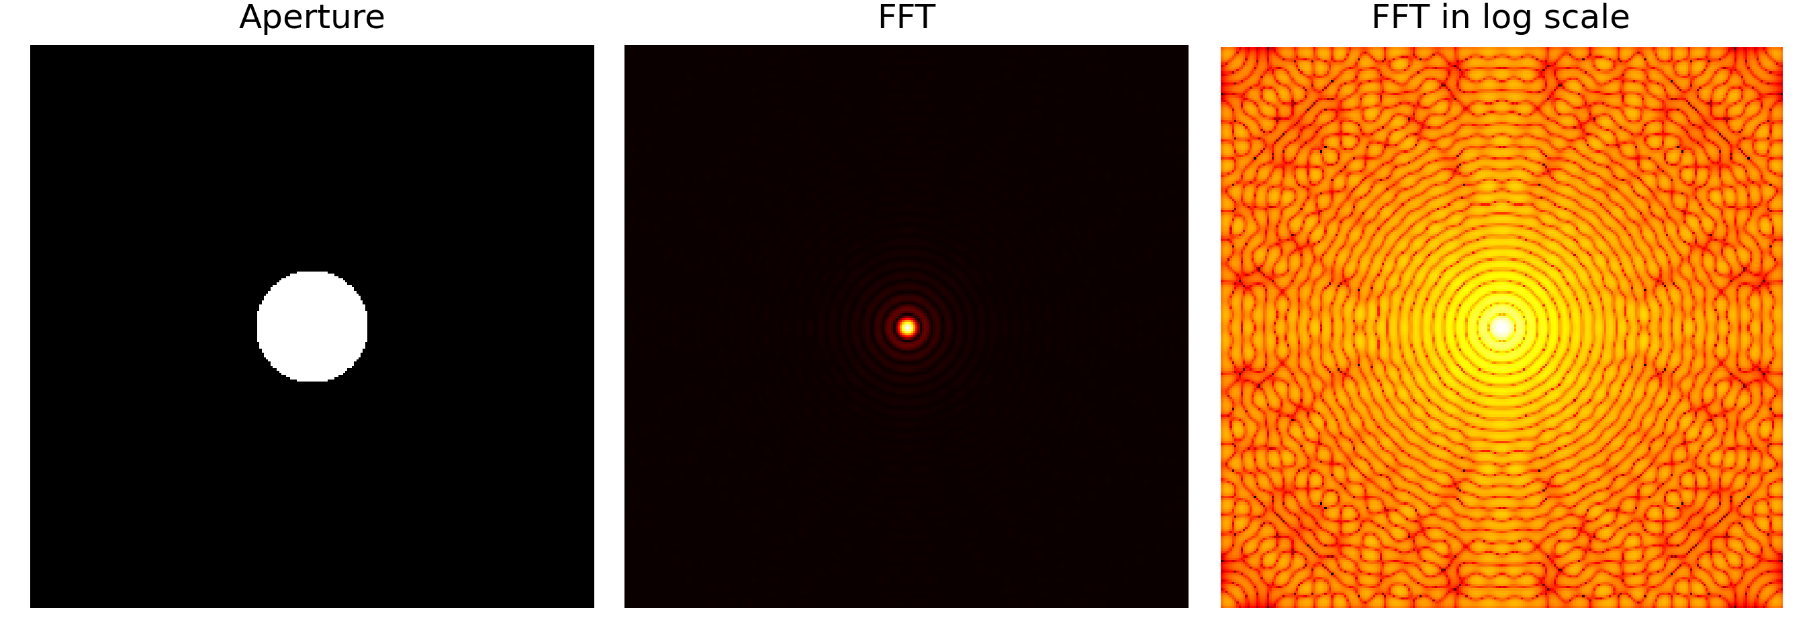
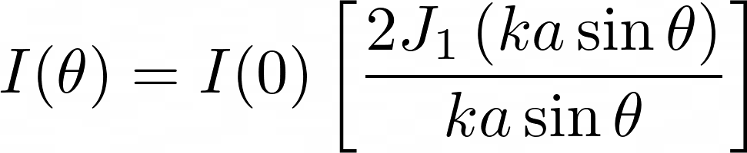
APP PHYSICS 157
FOURIER TRANSFORM MODEL OF IMAGE FORMATION
CIRCULAR APERTURES
Varying radii of circular apertures were considered, and it can be observed that the prominence of airy pattern decreases as the aperture radius increases. These airy patterns contributes to the extent of how light rays can get scattered as it passes through the said aperture, i.e. the radial patterns that propagate from the center represents the peaks at the real space domain. Interestingly, increasing the radius implies clearer image as the airy pattern diminishes. Hence, greater recovery on the details of an object is expected.
Figure 1. The FFT and FFT in log scale of circular apertures in varying radii.
In theory, the diffraction pattern intensity, as shown above, for a circular aperture takes the form of a Bessel function, which is evident in the patterns in the logscale FFT. This special function usually arises in systems that invokes radial symmetry like in optical diffraction and similar optical systems.

Slide 6
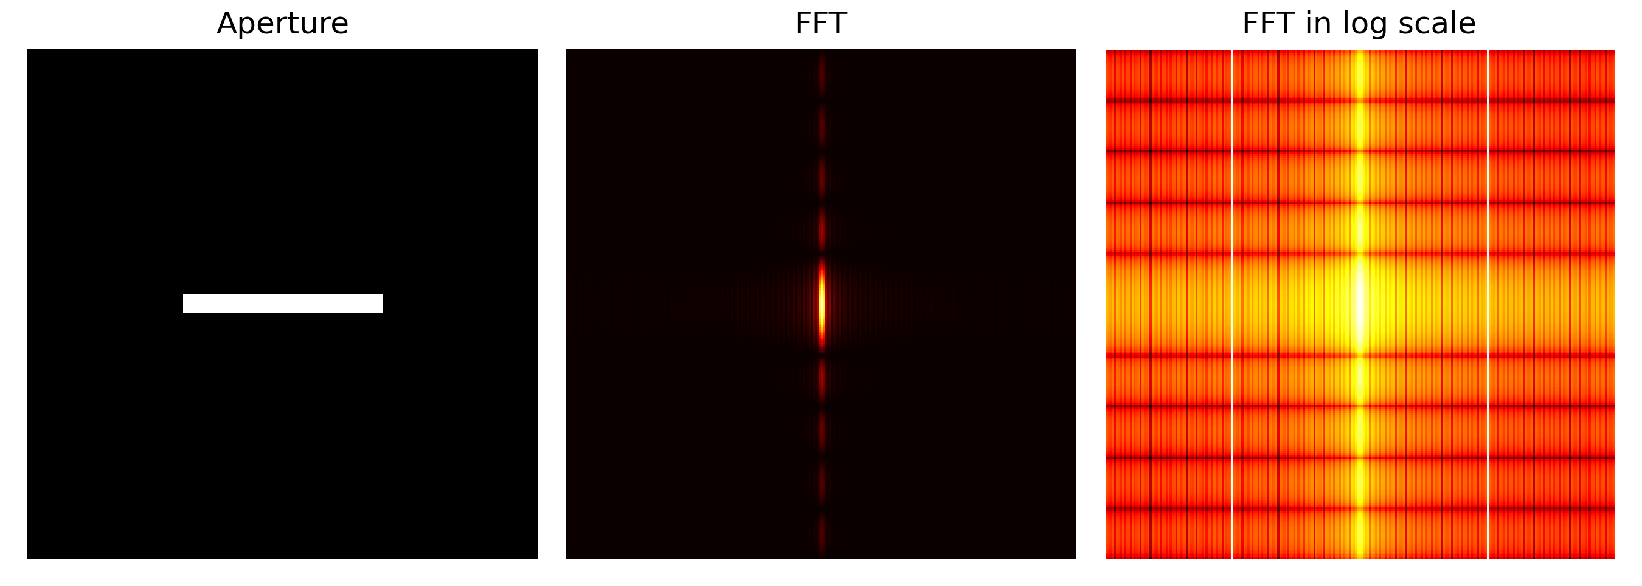
APP PHYSICS 157
FOURIER TRANSFORM MODEL OF IMAGE FORMATION
RECTANGULAR APERTURES
Other aperture geometry were also tried on for this activity. Rectangular apertures of varying widths and heights were made to resemble such single slit. The following observations were made as follows.
For a single slit oriented vertically, the resulting irradiance (FFT) was along the x-axis of the real plane, while the horizontal slit yielded a diffraction pattern along the y-axis. For both slits, the peaks in the Fourier space represents the bright streak of light along the center and diminishing peaks as it spreads throughout the space. For the special case of a rectangular aperture --- a square aperture resulted into a two-fold symmetry with prominent square in the middle, and smaller less-intense squares coming off away from the center along both axes. This wide spread of irradiance along a certain axis for the three slits can be hypothesized as to why certain animals has wide range of visions, owing to their pupil shapes!
Figure 2. The FFT and FFT in log scale of single slits.

Slide 7
APP PHYSICS 157
FOURIER TRANSFORM MODEL OF IMAGE FORMATION
REFLECTION
The latter parts of the activity that deals with basic image processing were challenging due to a number of reasons. The primary challenge upon working through the codes was deciding whether to work on float type values of 0 to 1 or RGB values of 0 to 255.
It has come to my realization that working on images is much easier for the latter as pixels are generally encoded in an 8-bit format, which is favored by coding algorithms and the mathematical representations in general. Perhaps, an application to what I have learned on my App Physics 155 class is to have consistency in my codes your variables.
I think I could have written my codes and notebooks in a much cleaner way, but, overall, I think I was able to execute the rudimentary of image processing in Python and even meet what is expected beyond the objectives. The white balancing algorithms such as GWA and WPA have its pros and cons depending on the kind of image you are using as GWA tends to favor images with gray areas while WPA needs a white patch focus to work. Contrast stretching can be also be used to restore unbalanced images. Overall, I believe I was able to address some gaps and nuances in my results as the choices of my image are somehow not fit in terms of contrast levels. Overall, I would give myself a score of 100/100.

Slide 8
APP PHYSICS 157
DIGITAL IMAGE FORMATION AND ENHANCEMENT
ACKNOWLEDGEMENT
I would like to acknowledge the time and knowledge Sir Rene and Sir Kenneth have shared to us during our laboratory activities when it comes to debugging and addressing some code issues. I also would not have done this without the help of Edneil Soriano and Julian Maypa upon resolving some mistakes I made in code structures and stuff.
REFERENCES
M. Soriano, Applied Physics 157 – Digital Image Formation and Enhancement, 2023
Creating Histograms – Image Processing with Python (datacarpentry.org)
Understanding image histograms with OpenCV
White Balancing — An Enhancement Technique in Image Processing
GITHUB REPOSITORY
npcrmns/App-Physics-157: Computational Analysis and Modelling in Physics (github.com)

